Slide 1
Global Food Wastage By: Ishaq Khan

Slide 2

About me
Born in San Antonio, raised in McAllen since I was 1.
Bachelors in Computer Engineering.
Current working as a Network Support Specialist and passionate about business intelligence and data analytics.

Slide 3
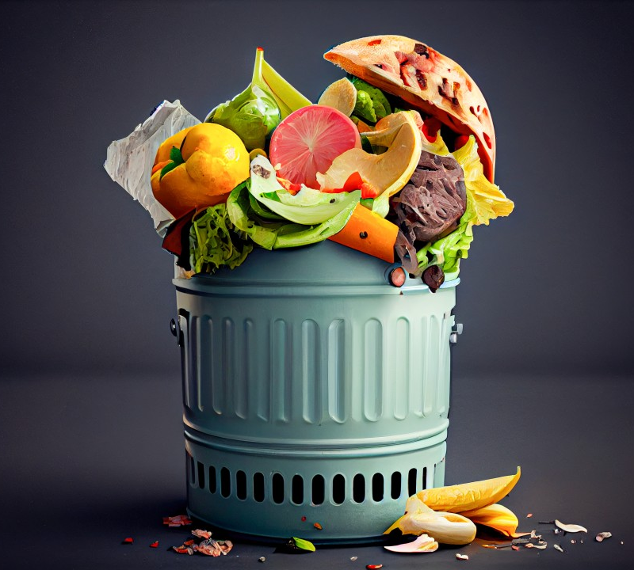
Topic: Global Food Wastage
According to the World Food Programme, One-Third of food produced for human consumption is lost or wasted globally.
All the food produced but never eaten would be sufficient to feed two billion people.

Slide 4
An Ever-growing Issue
With the global food wastage seeing no end, lets try and analyze where we can locate part of this issue to help reduce the impact we can have on the environment.

Slide 5

Data Source

Slide 6
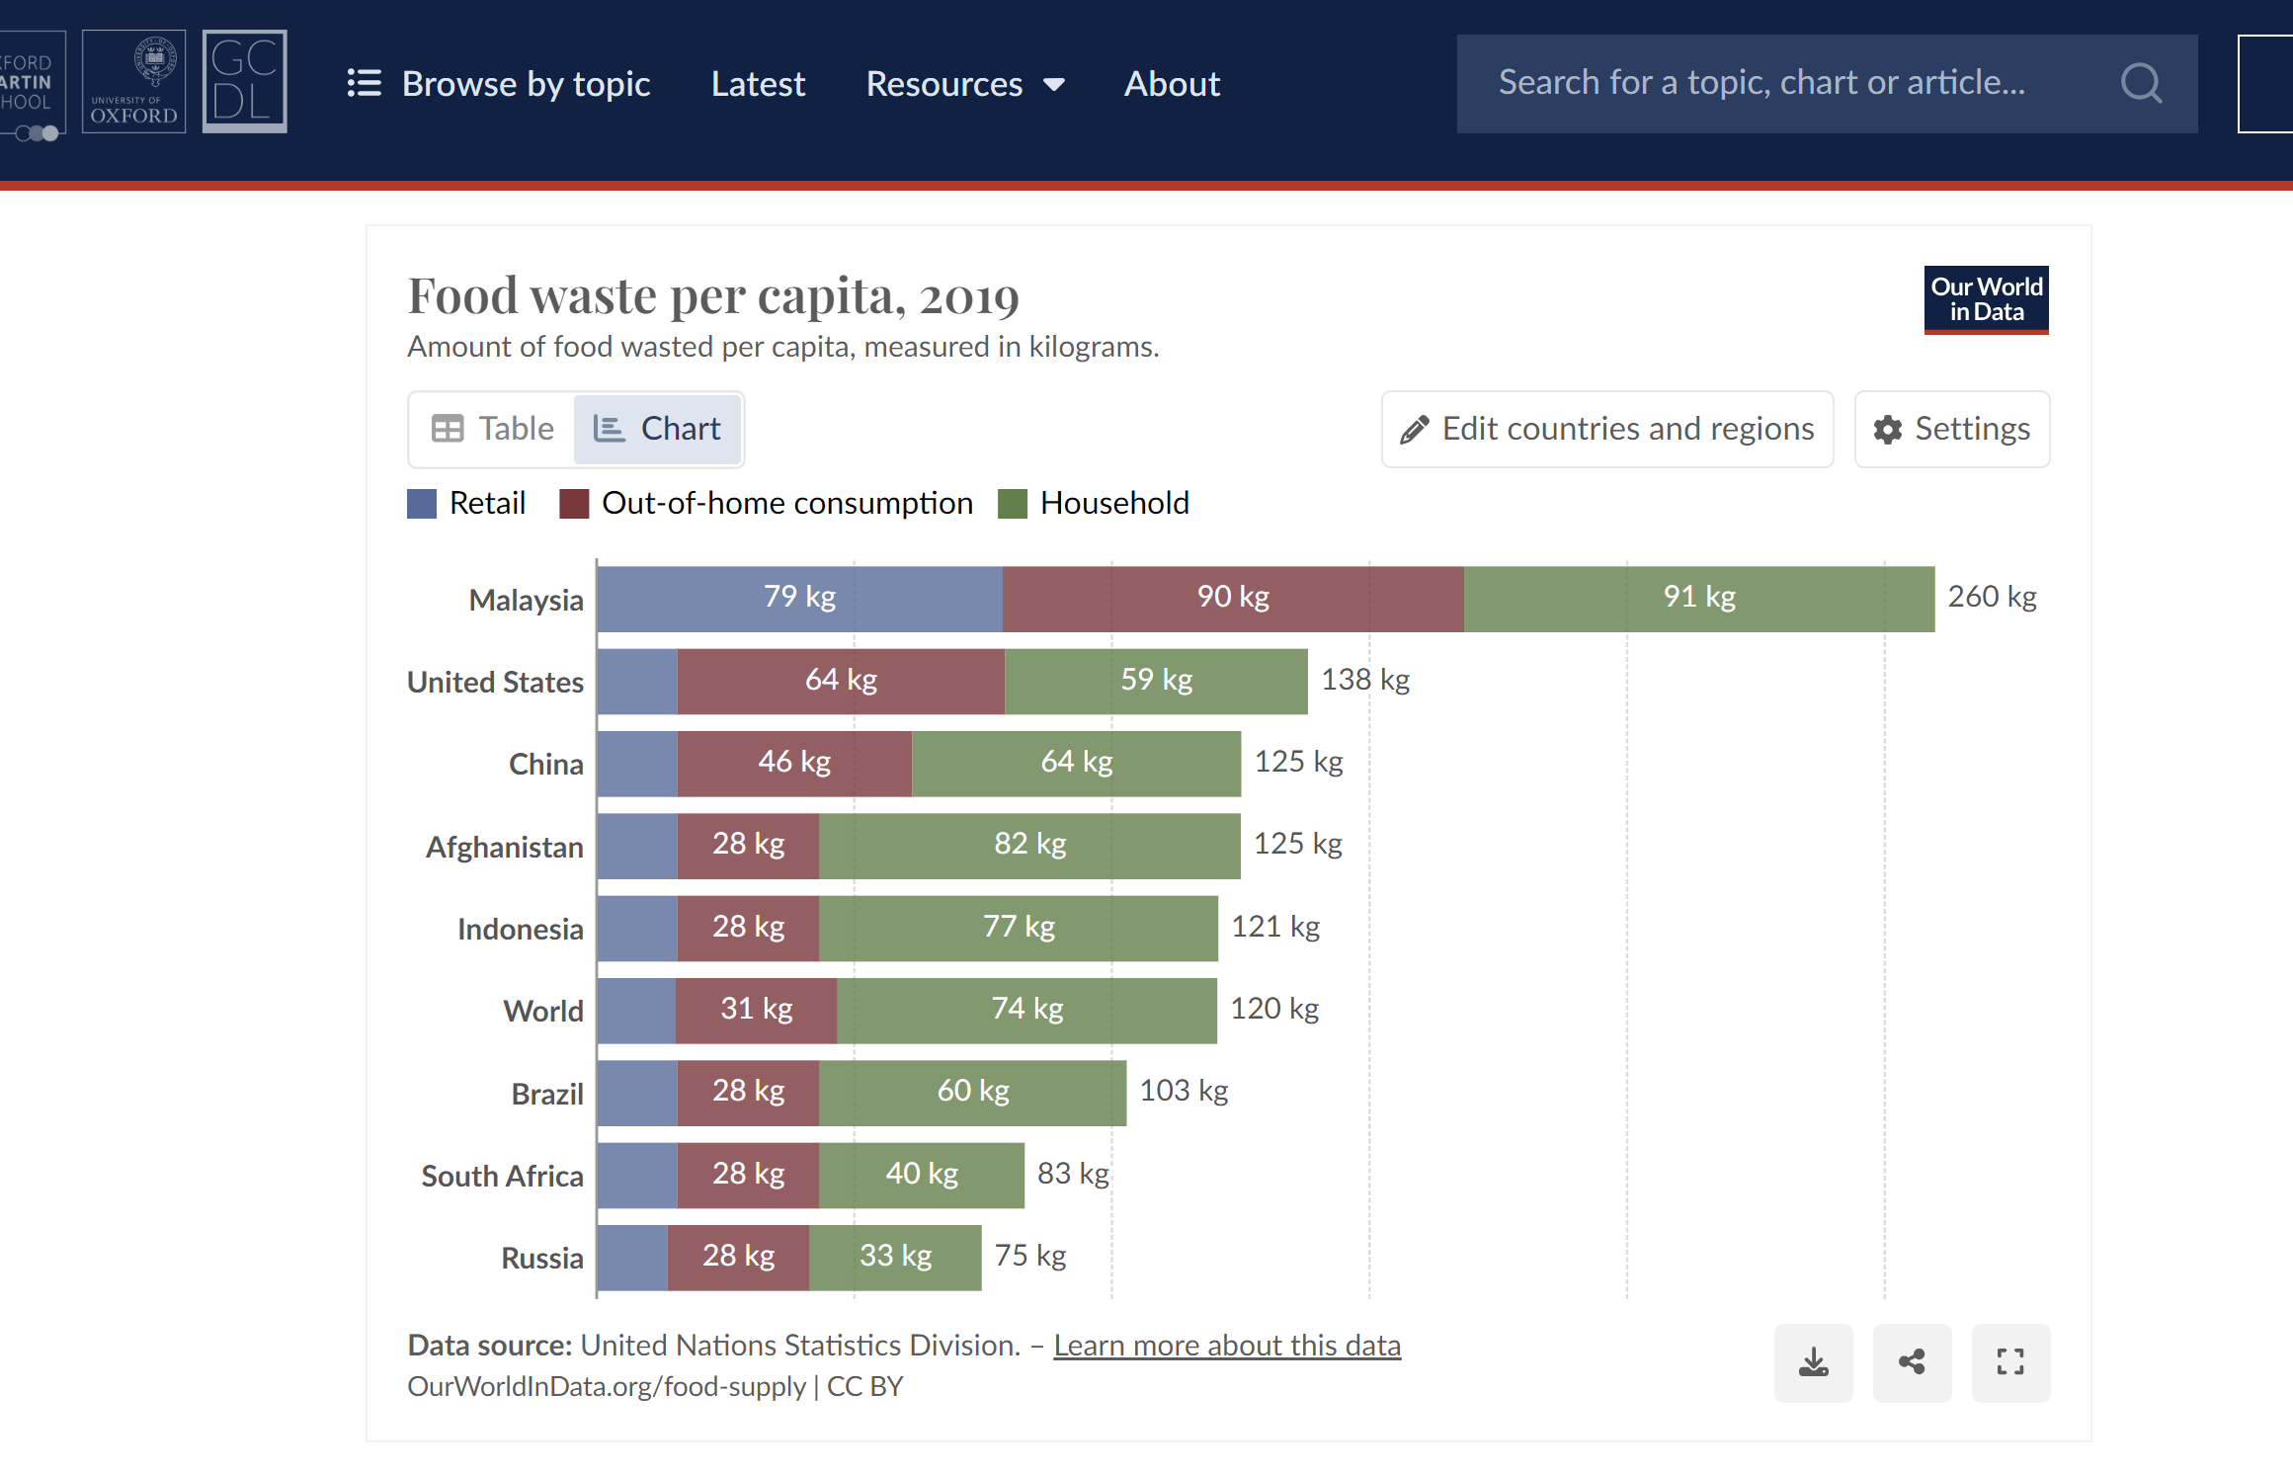
Data Set
The data was discovered on “Our World in Data”.
Data consist of the Food Waste per Capita in the year 2019.
The Data Source consists of:
Country
Region
GDP
Year
Retail Waste
Out-of-Home Waste
Household Waste
Total Food Waste per Capita

Slide 7
Goal
Provide insights into the per capita food waste across various countries.
Explore the global food disparities in food waste.
Focus on Sustainability and Waste Reduction.
Uncover best practices and propose strategies to mitigate food waste, ultimately contributing to more sustainable food systems.

Slide 8

Analysis
Finding the Answer to a global issue

Slide 9
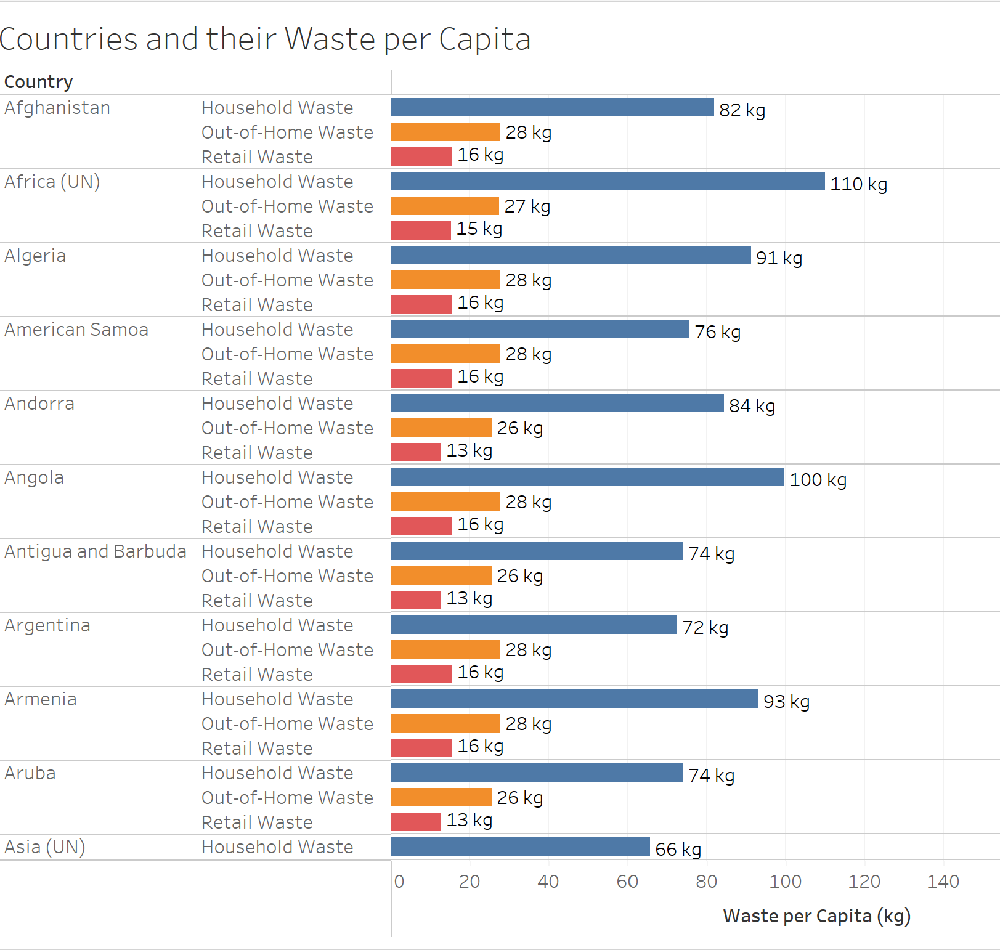
Countries and their Waste per Capita
Lists all the countries in the world.
Each country lists three waste categories:
Household
Out-of-Home
Retail
Shows the Waste per Capita of each category of every country.

Slide 10
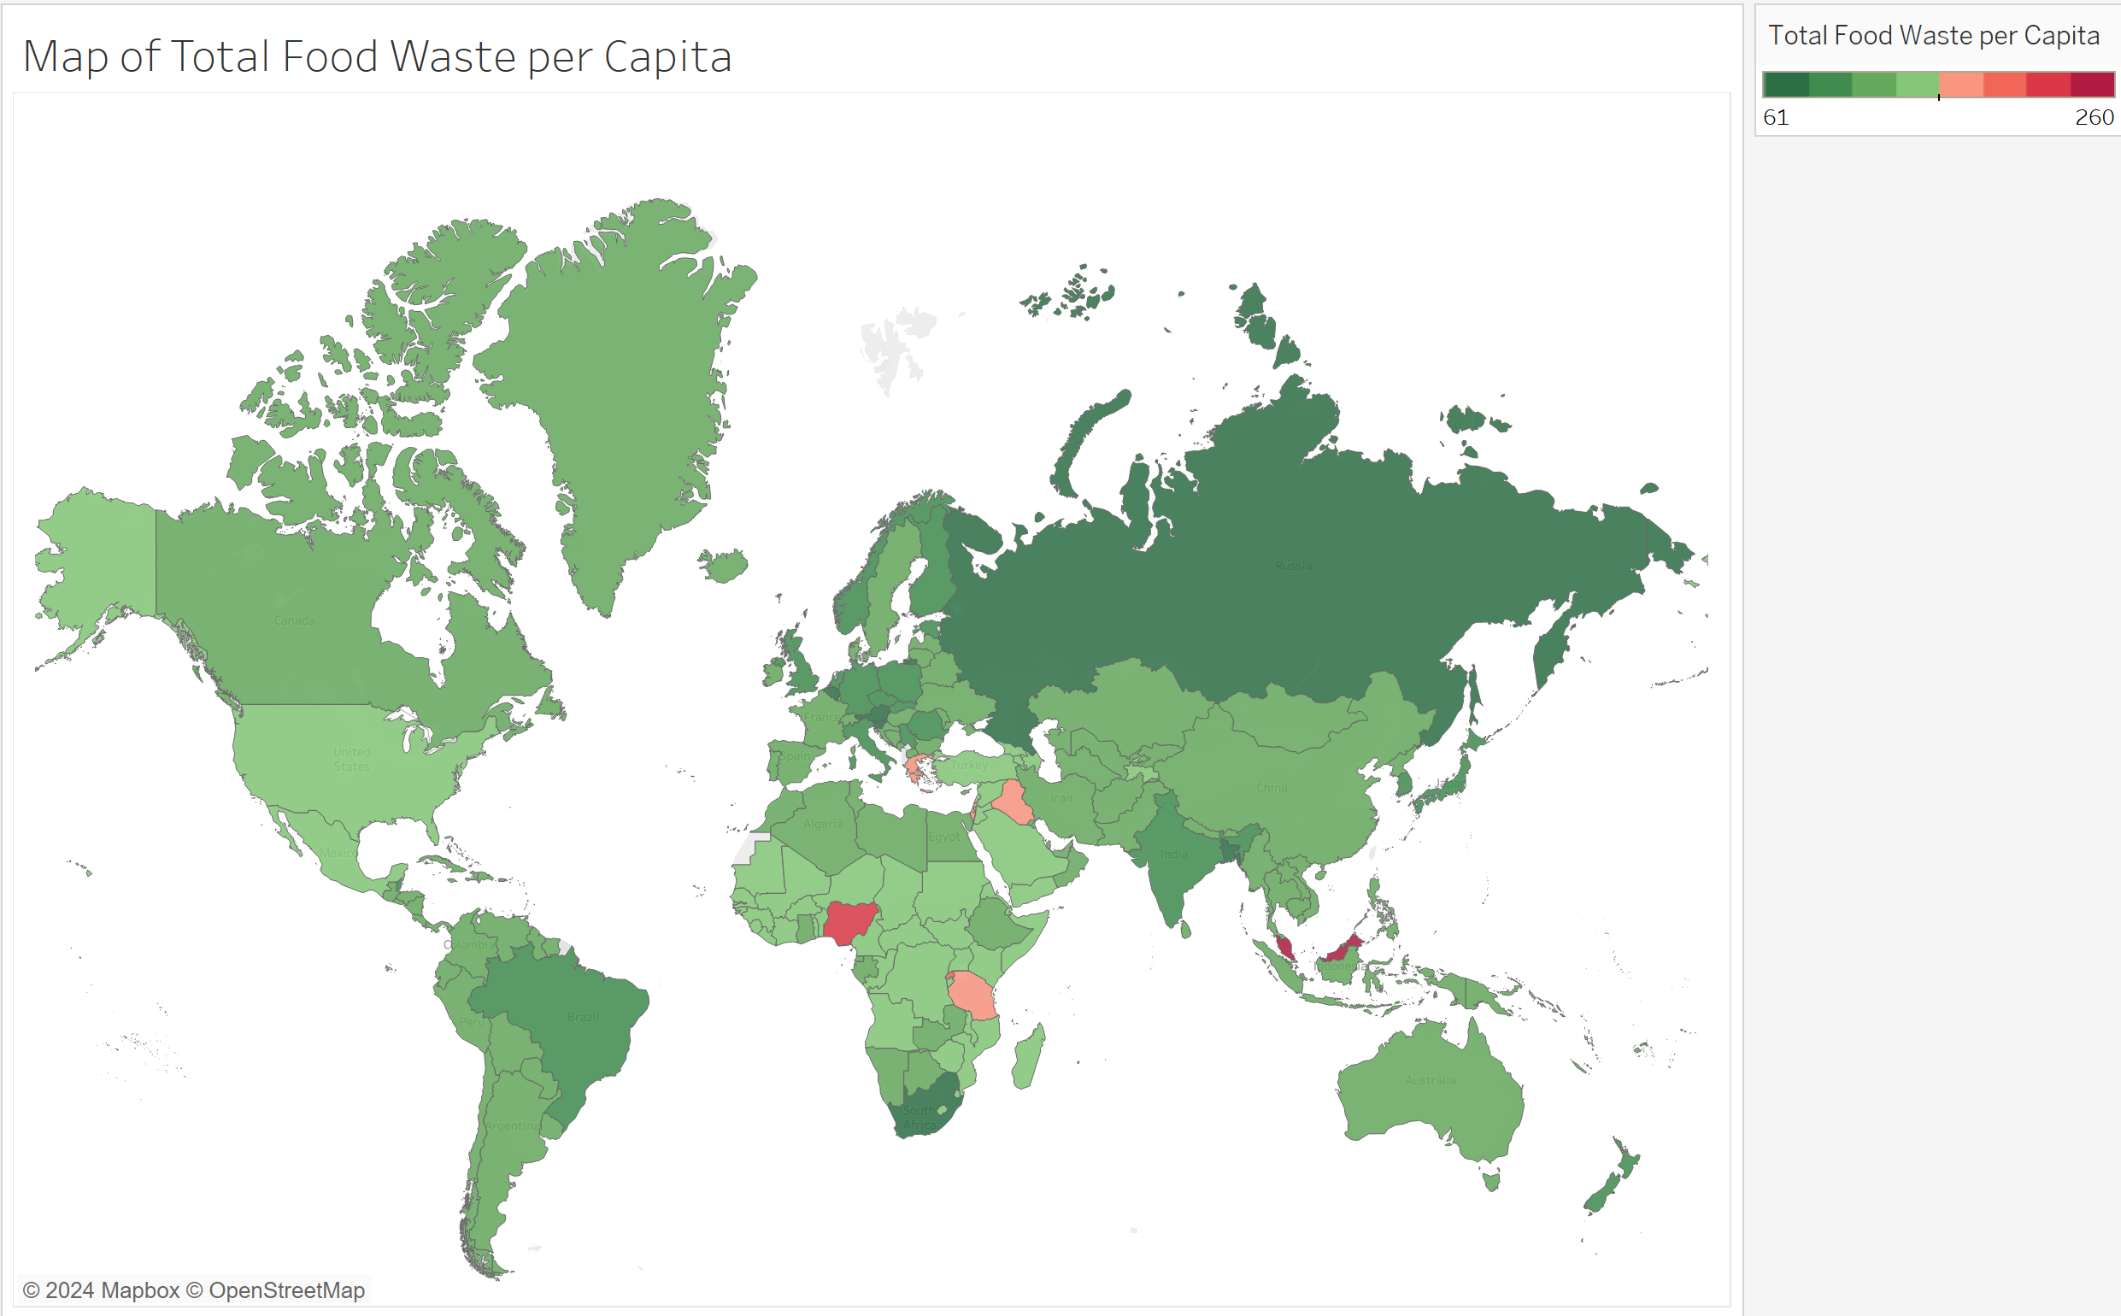
Map of Total Food Waste per Capita
Shows a world map of all the countries.
Legend indicate the level of food wastage based on the minimum and maximum total food waste.
The greener the country, the less food wastage per capita occurs.
The redder the country, the higher the food wastage per capita is.

Slide 11
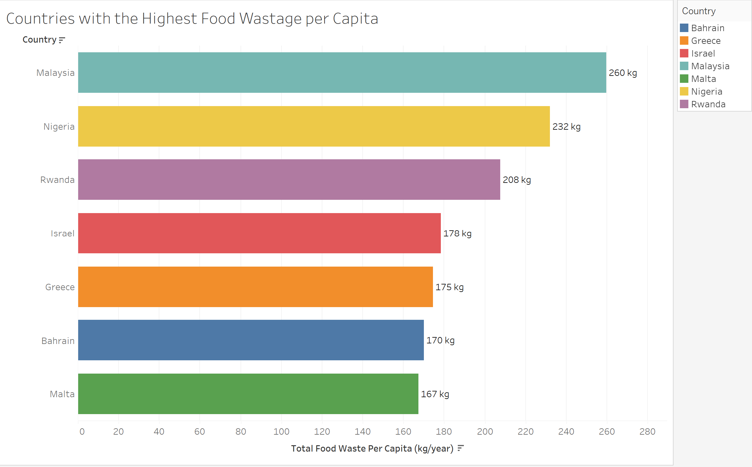
Countries with the Highest Food Wastage per Capita
Top 7 countries with the Highest Food Wastage per Capita:
Malaysia
Nigeria
Rwanda
Israel
Greece
Bahrain
Malta
Acknowledge by the fact that the information is on a “per Capita” basis, meaning the average per person.
Calculations considers population of the Country, meaning a country with a smaller population can have a higher Total Food Waste per Capita than a country with a larger population.

Slide 12
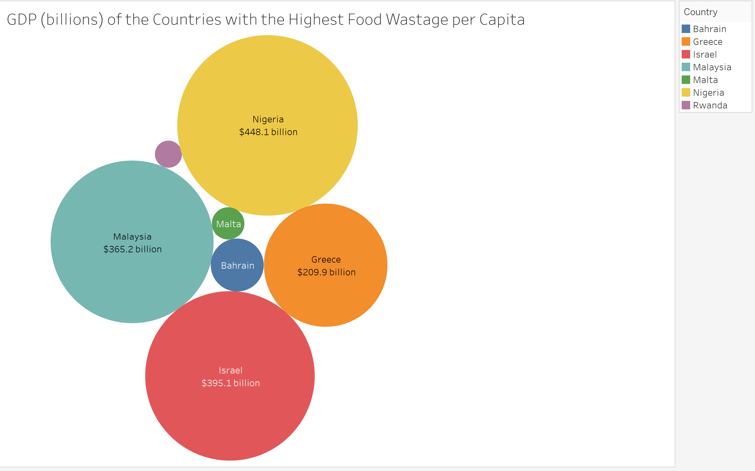
GDP of the Countries with the Highest Food Wastage per Capita
Shows the GDP of the Countries with the Highest Food Wastage per Capita
Size of the circles are in relation to the GDP of the respective country
Note, some names and values are not showing up due to the graphics processing but does show up on the tooltip.

Slide 13
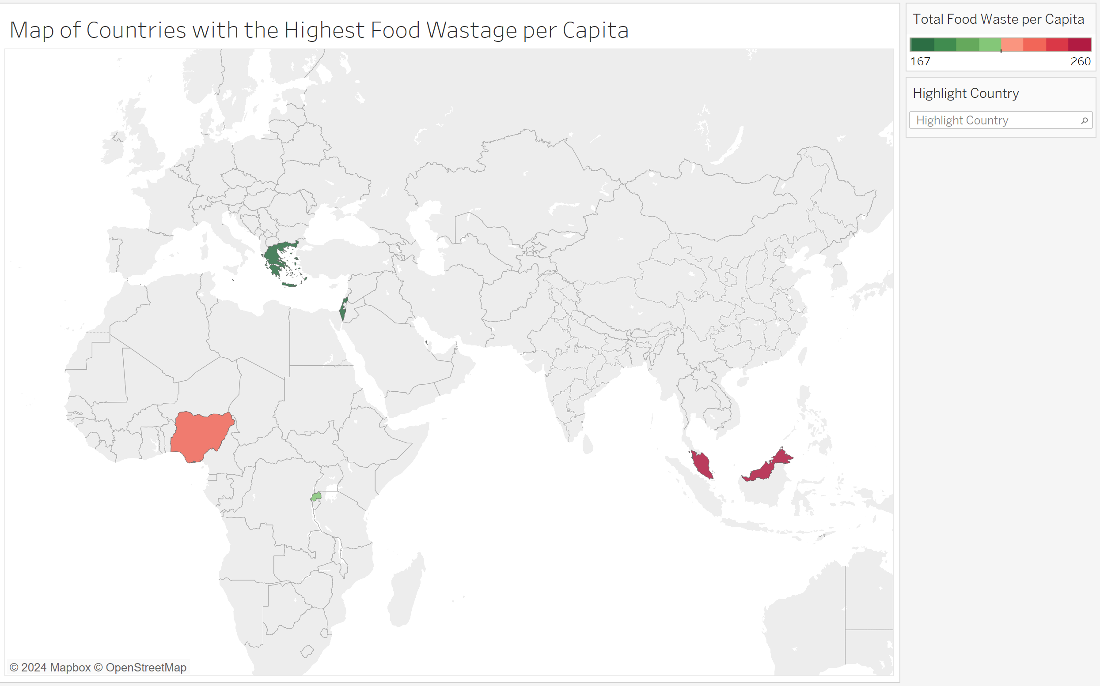
Map of Countries with the Highest Food Wastage per Capita
Map shows the seven countries with the Highest Food Wastage per Capita.
Countries are commonly located in the following regions:
Africa
Europe
Asia
Regions are highly susceptible to higher food wastage on a per Capita basis.
Interventions must be taken to reduce impact.

Slide 14
Interventions and Preventions
Steps to success

Slide 15
A multi-faceted approach
Consumer Education and Awareness
Campaigns and Education Programs to promote awareness about impact of food wastage
Proper food storage, portion sizes, and importance of using leftovers.
Improving Supply Chain Efficiency
Better Forecasting and Inventory management by using advanced analytics to predict demand more accurately and reduce overproduction.
Food Recover and Redistributions
Food Banks and Donation Programs by encouraging retailers and providers to donate surplus food to food banks and shelters.
Policy and Regulations
Implement policies that incentivizes food waste reduction like tax benefits for food donations and penalties for excessive waste.
Develop comprehensive food wastage strategies at both national and local levels, setting clear targets and timelines.
Cultural and Behavioral Changes
Foster cultural shifts that value food and discourage wasteful practices
Using behavioral science to design interventions that nudge consumers towards less wasteful habits.

Slide 16
Challenges
Roadblocks to success

Slide 17
Encountering setbacks
Various issues occurred when building and collecting information to present a case.
Not enough data in dataset
Had to include data about GDP and Region
Presenting the information to showcase a story.
Dataset not being recognized by Tableau immediately
Remembering filtering and sorting techniques.

Slide 18
Thank you
Ishaq Khan
Final Project
Data Visualization
INFS-6356

Slide 19
Source
https://www.wfp.org/stories/5-facts-about-food-waste-and-hunger

